Slide 1

WAY TO ENTERPRISE
AWS
VTI ACADEMY
Author: duy.nguyenngoc1@vti.com.vn

Slide 2
Agenda
Lambda Service
API Gateway
Step Functions Service & Simple Workflow Service
Serverless Architecture
Assignments
Quiz
Copyright © VTI Academy All Rights Reserved

Slide 3
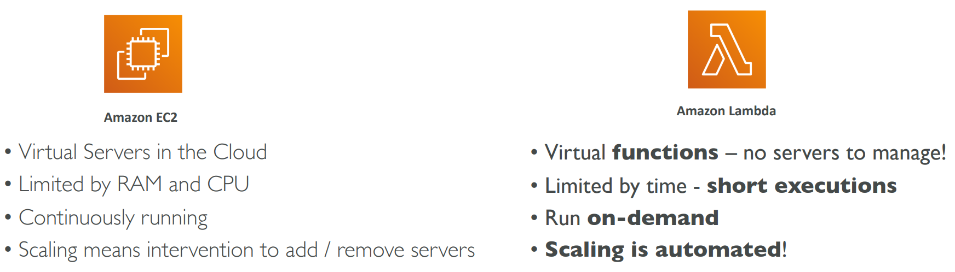
Lambda Service
Is a computing service that run code without OS management
Serverless Service, No servers to manage, Just upload code & run on-demand
  No need to manage HA, automatic scaling, monitoring, ..., CPU management, Networking, ...
Integrated with AWS Services (S3, DynamoDB, SQS, SNS, Kinesis, Cognito, ...)
Tutorial: https://docs.aws.amazon.com/lambda/latest/dg/welcome.html

Slide 4
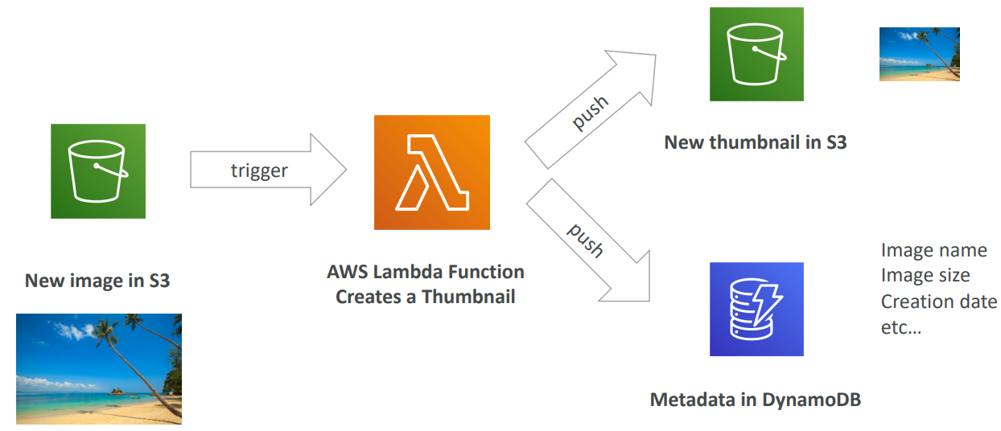
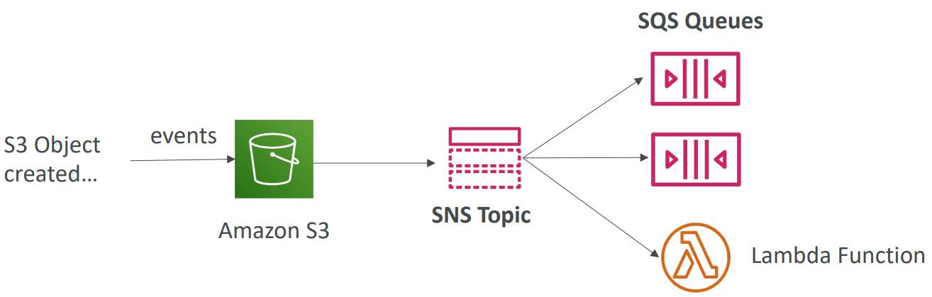
Lambda Service
Usecases
Build data-processing triggers for AWS services (S3, DynamoDB)

Slide 5
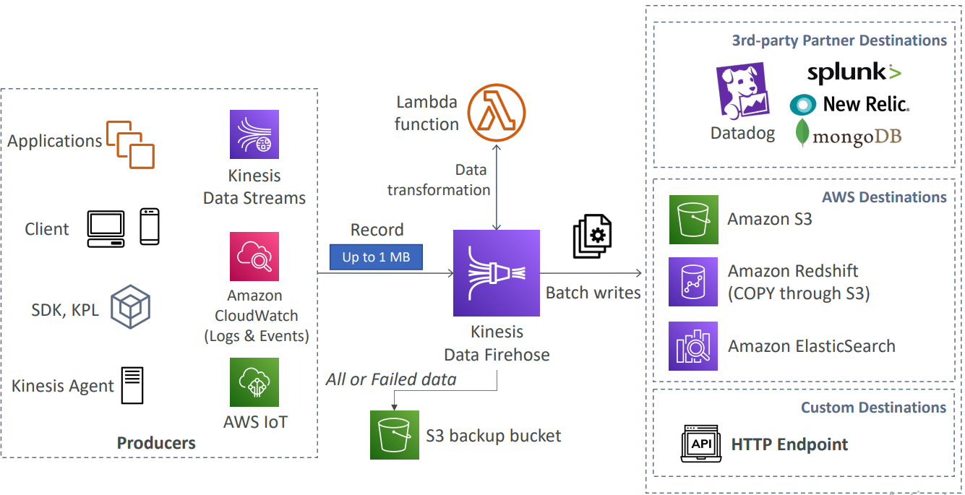
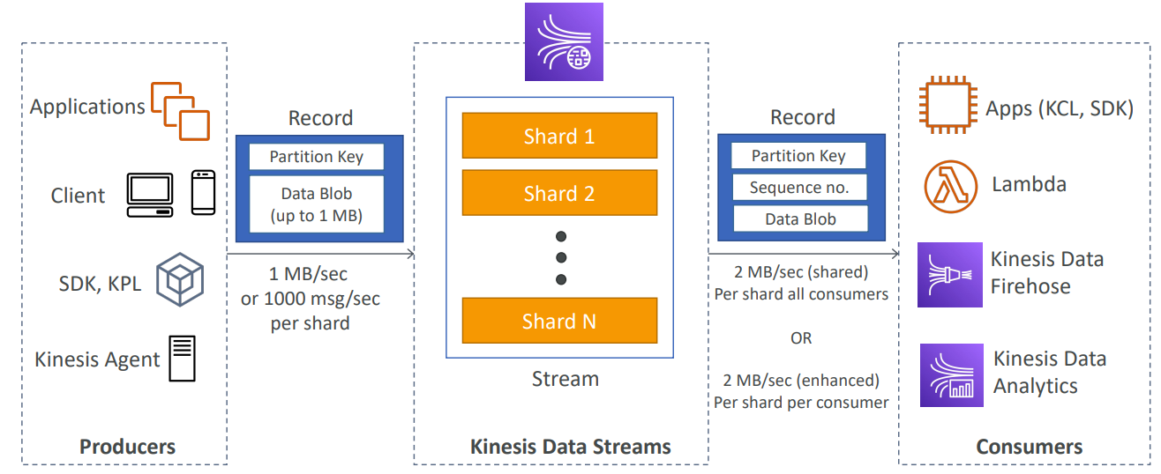
Lambda Service
Kinesis Data Streams
Kinesis Data Firehose
Process streaming data stored in Kinesis

Slide 6
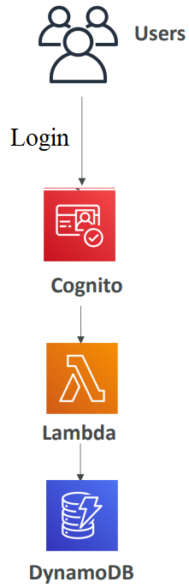
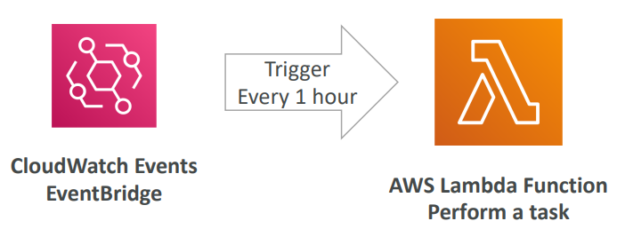
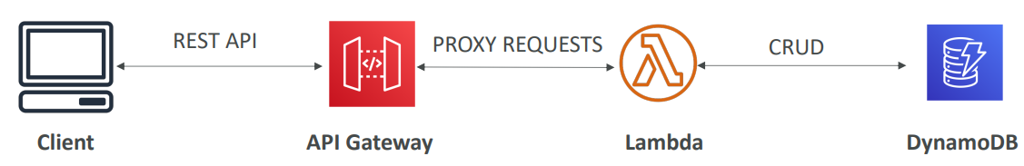
Lambda Service
CRON Job
Using like backend (Auto scaling, HA) for Web/Mobile Application

Slide 7
Lambda Service
Limit
  RAM: 128 MB - 10GB, Disk capacity : 512 MB (/tmp)
  Maximum execution time: 900 seconds (15 minutes)
  Environment variables (4 KB)
  Concurrency executions: 1000 (can be increased)
  Deployment size (compressed .zip): 50 MB
  Size of uncompressed deployment (code + dependencies): 250 MB
Price: Very cheap - https://aws.amazon.com/lambda/pricing

Slide 8
Lambda Service
Language support
  Node.js, Python, Java, C#, Golang, Ruby, ...
  Custom Runtime API (community supported, example Rust)
  Lambda Container Image
    The container image must implement the Lambda Runtime API
    ECS / Fargate is preferred for running arbitrary Docker images

Slide 9
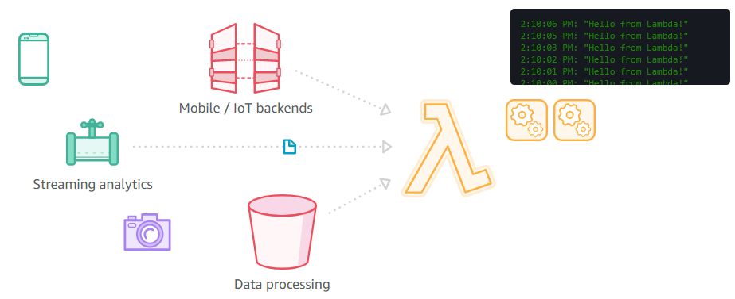
Lambda Service
Demo
  Create Lambda Function (Author from scratch)
  Test
  Create Lambda Function (blue print)
  Test
https://ap-southeast-1.console.aws.amazon.com/lambda/home?region=ap-southeast-1#/begin

Slide 10
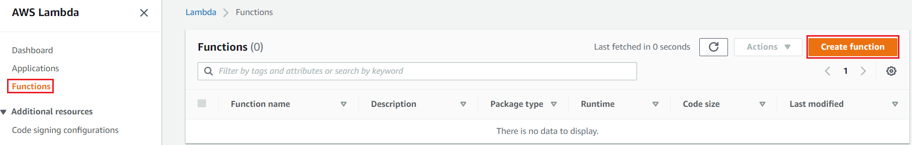
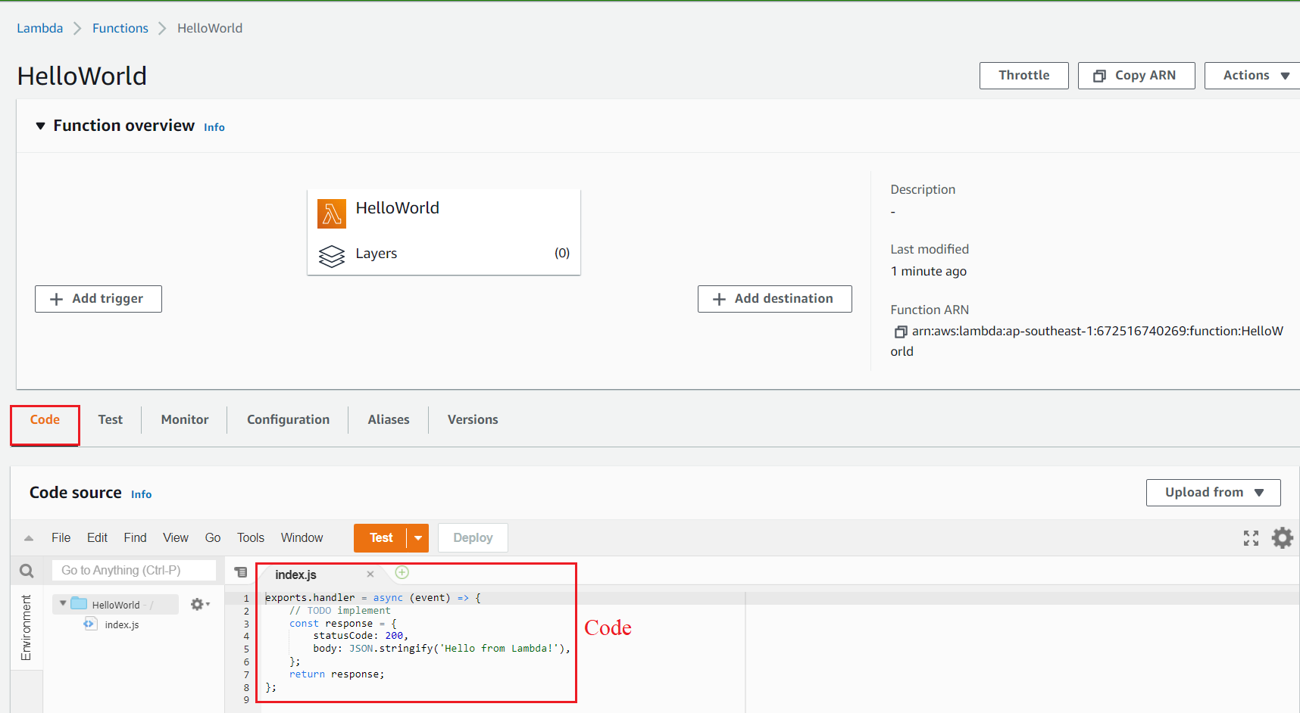
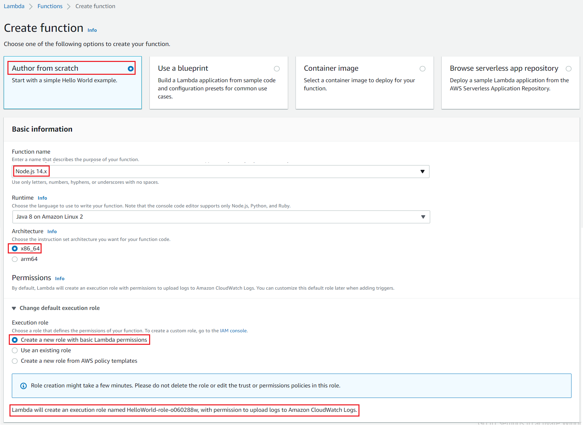
Lambda Service
  Create Lambda Function (Author from scratch)

Slide 11
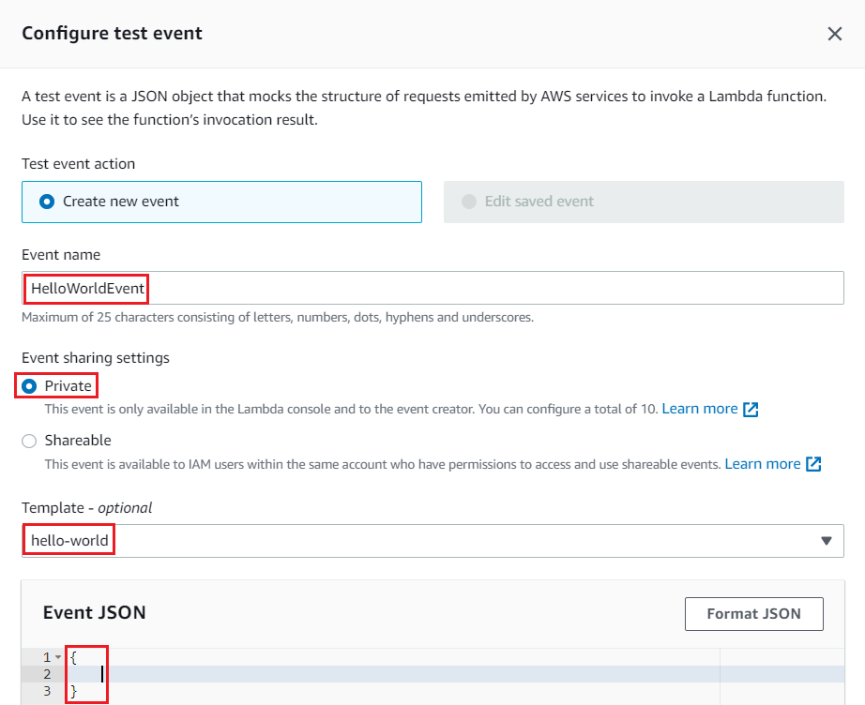
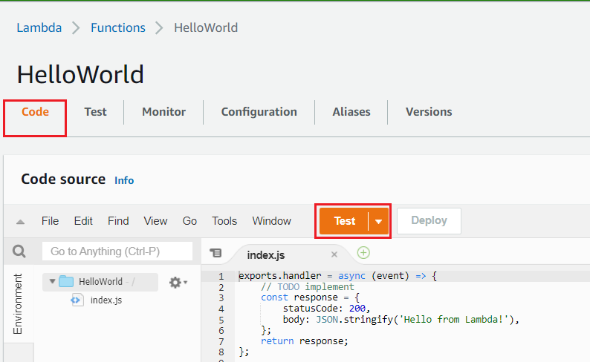
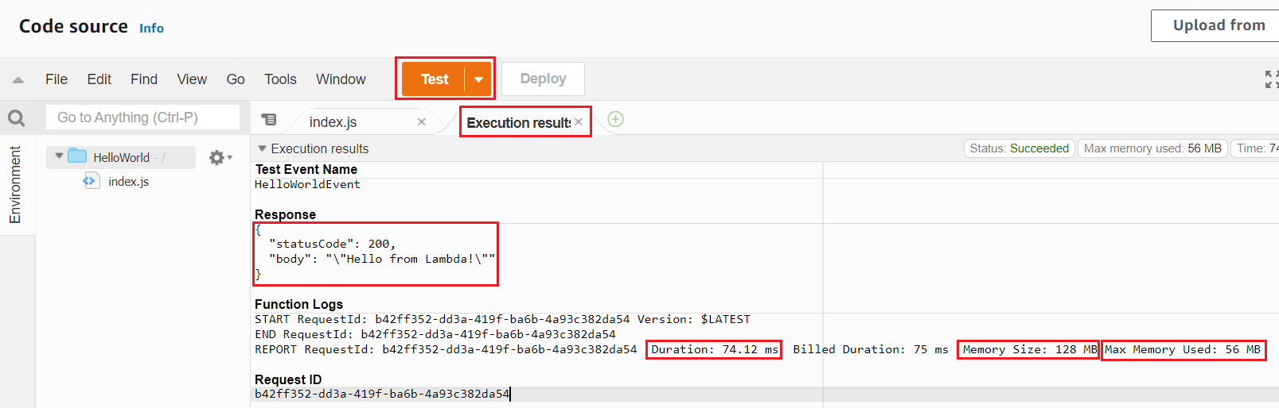
Lambda Service
  Test

Slide 12
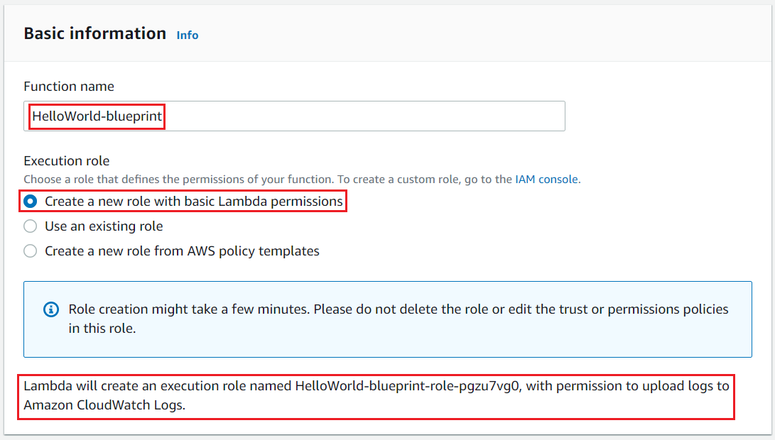
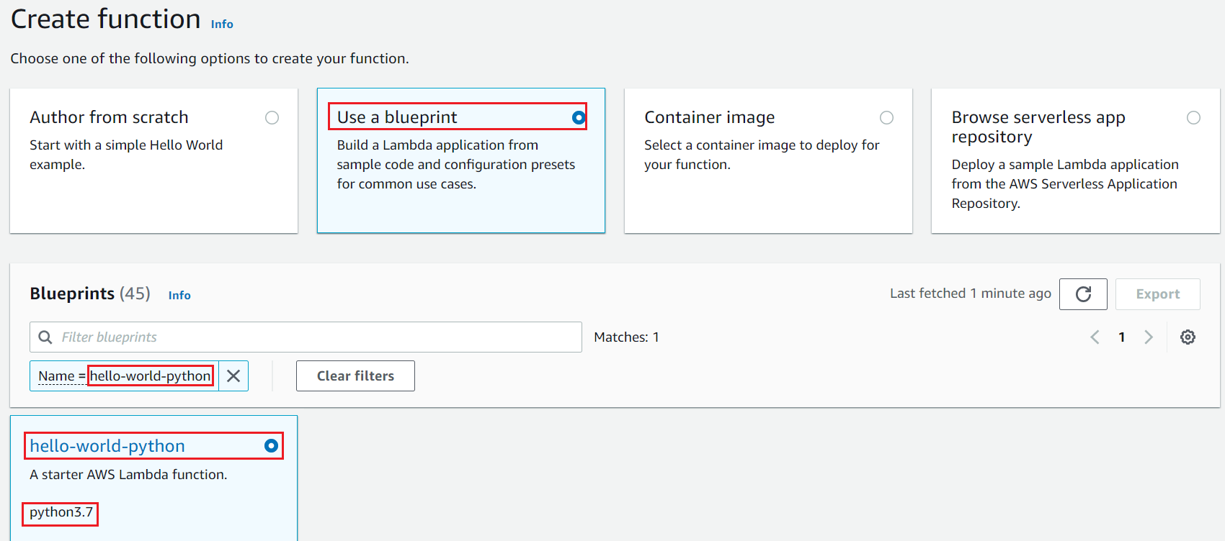
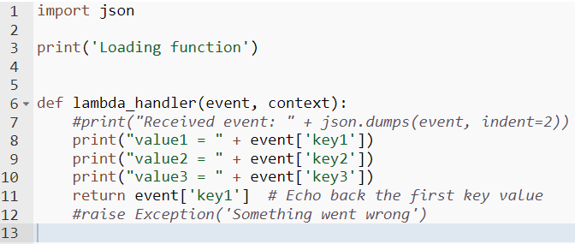
Lambda Service
  Create Lambda Function (blueprint)

Slide 13
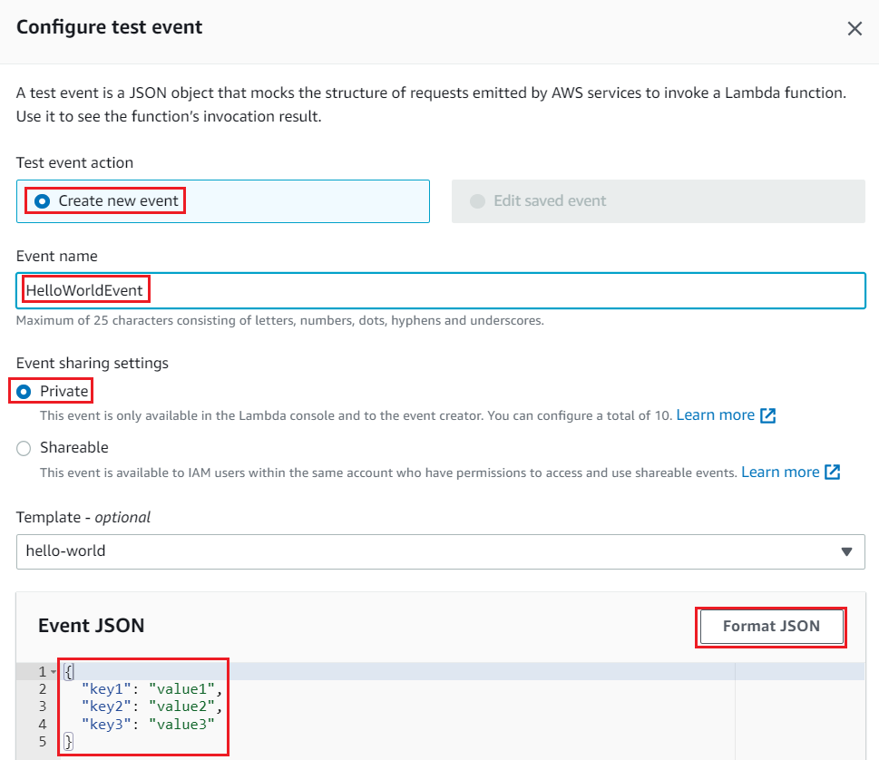
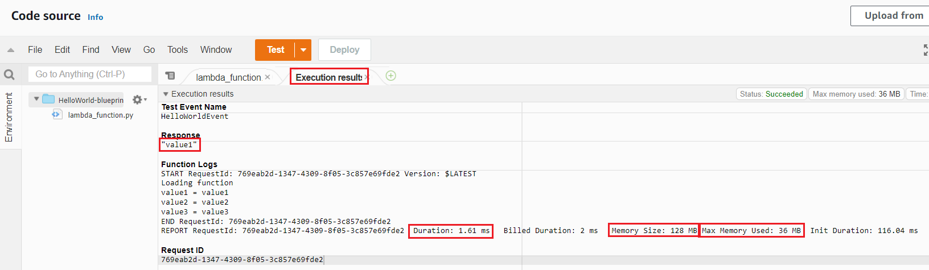
Lambda Service
  Test

Slide 14
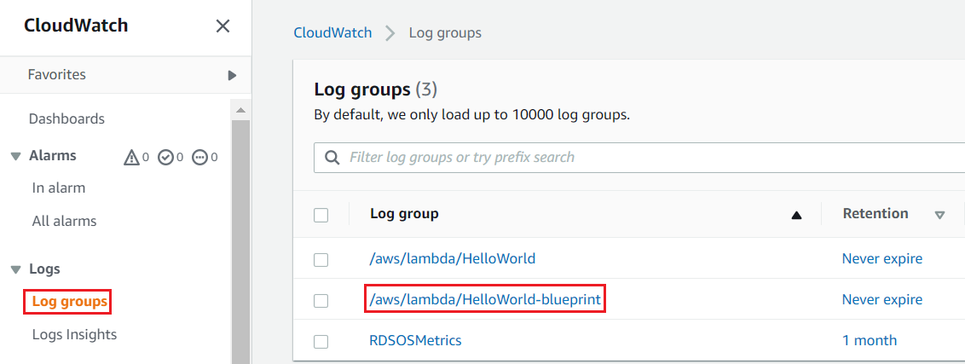
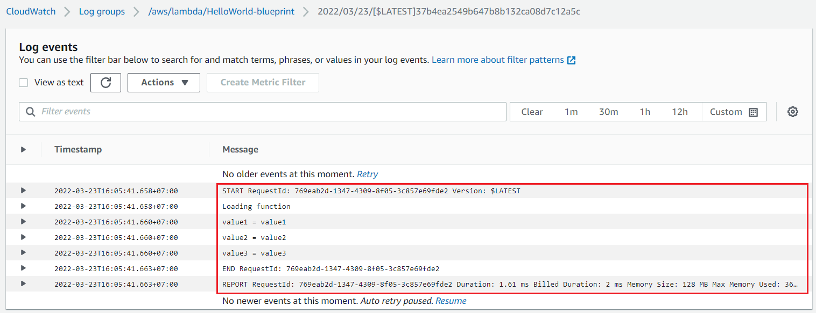
Lambda Service
View CloudWatch Log

Slide 15
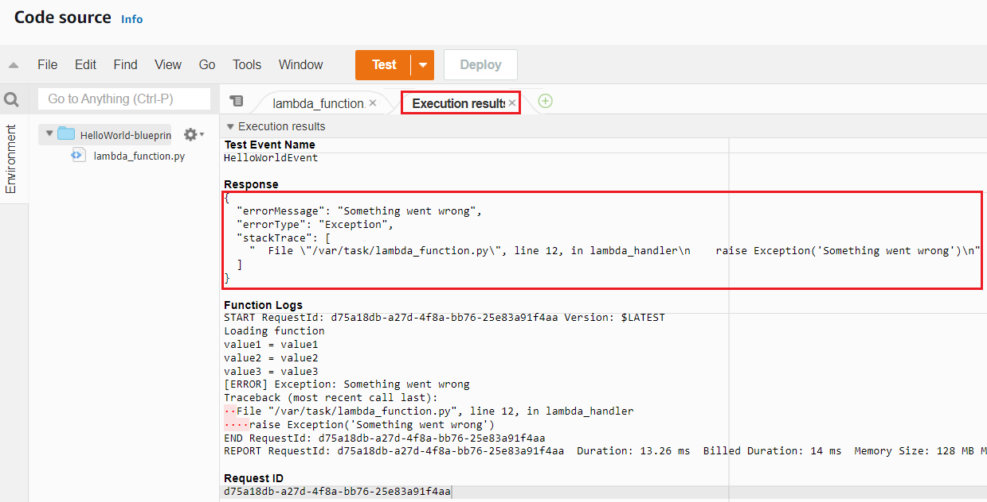
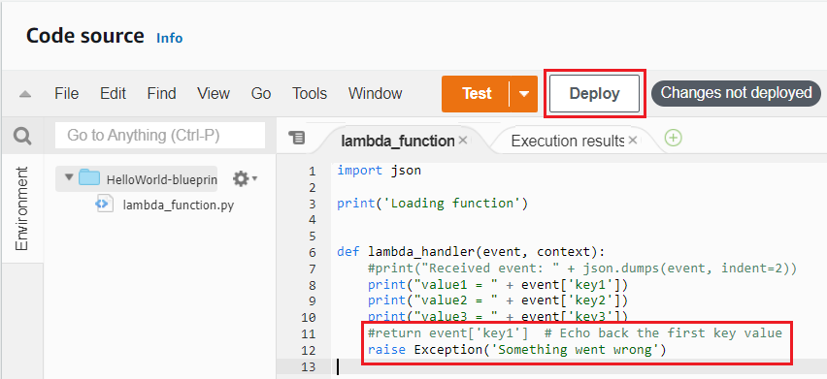
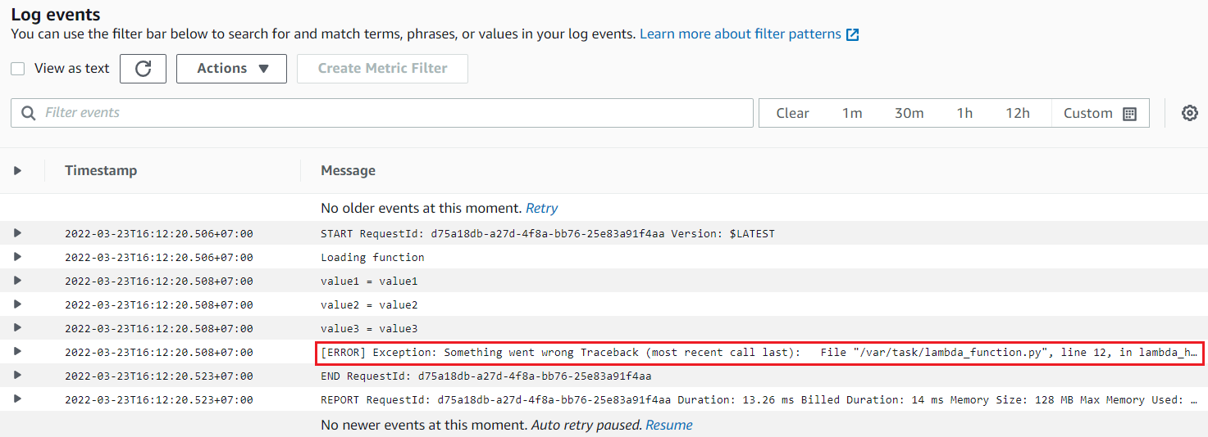
Lambda Service
Change code
Test
View CloudWatch Log

Slide 16
Lambda Service
Other Demo
  Automate EBS Snapshot: https://youtu.be/62ju_iFXoHE?t=818
  Copy Object S3: https://www.youtube.com/watch?v=97q30JjEq9Y
  https://www.youtube.com/watch?v=XZggsCITQdY&t=526s

Slide 17
Assignment
  Self-practice

Slide 18
Lambda Service
Components
  Lambda function
  Invoking Function
  Destination

Slide 19
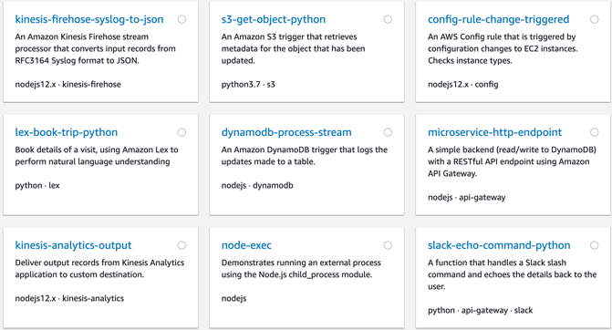
Lambda Service
  Lambda function
    How to create Lambda Function
      Author from scratch: Empty Function
      Blueprint: Template code for Node.js & Python
      Container image: Using docker image
      Serverless app repository
    Components: Runtime, Code, Concurrency, Network, Database proxy, File system, Monitoring, ...
Blueprint

Slide 20
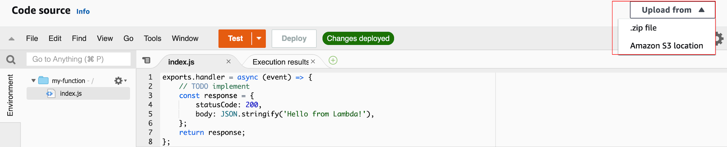
Lambda Service
    Runtime
      Support Node.js, Python, Java, C#, Golang, Ruby, ...
      Architecture: x86_64, arm64 (higher performance)
      Memory: 128 MB 🡺 10 GB, Disk capacity : 512 MB 🡪 10 GB
      Maximum execution time: 900 seconds (15 minutes)
    Code
      Event (Parameter, Json), Context, Callback, Environment variable (Max 4KB)
      Using Lambda Layer to upload libraries, dependencies, ... (Max 50MB)
      Support write code with Lambda Editor (Tutorial)
        Or upload code from S3, On-premises

Slide 21
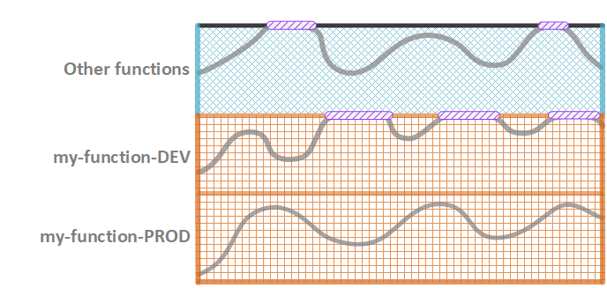
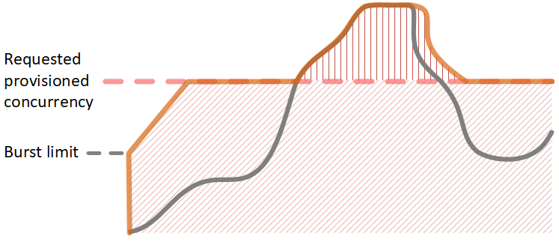
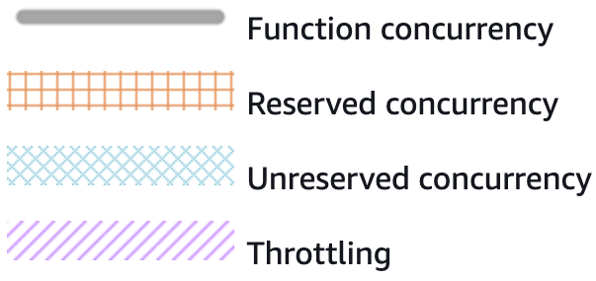
Lambda Service
    Concurrency
      Max 1000 Concurrency (can be increased)
      2 types
        Reserved concurrency: Config max concurrency
        Provisioned concurrency: auto scaling based on workload
Reserved concurrency
Provisioned concurrency

Slide 22
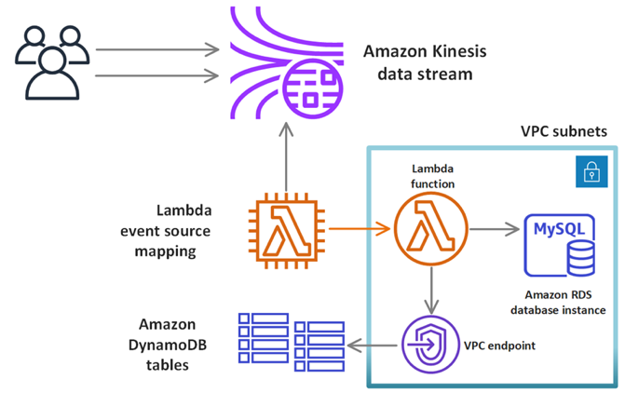
Lambda Service
    Network
      By default, the Lambda is public over the internet
      You can configure Lambda to run only in VPC (private)
    Database proxy / File system
      Config proxy for Lambda Function accessing RDS / File system
    State Machine: Handling error for Lambda Function
    Alias, Version, Security (Code Signing)
    Monitoring: CloudWatch

Slide 23
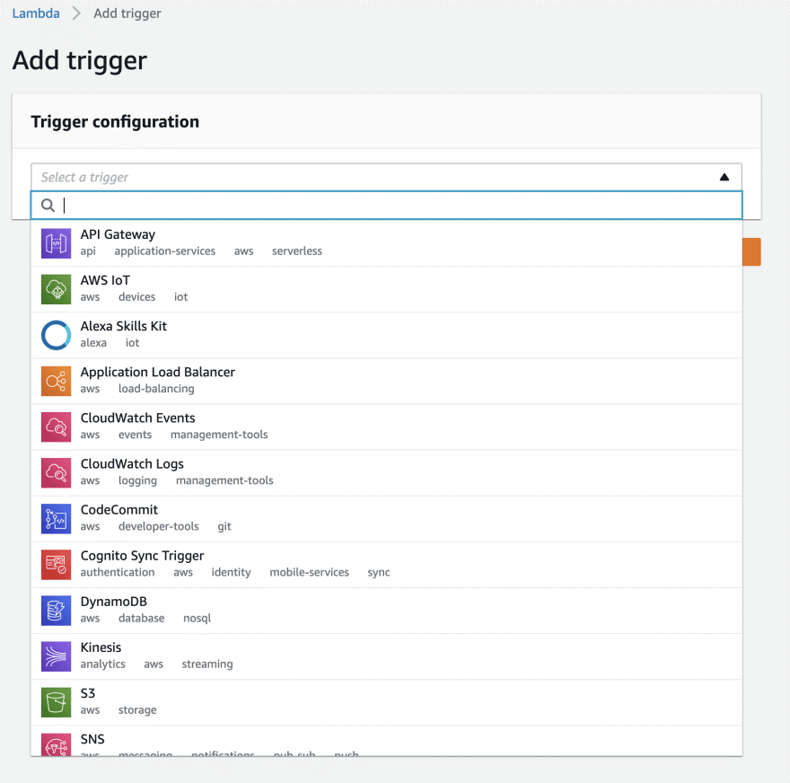
Lambda Service
  Invoking Function
    Test: Max 10 test / 1 function
    Trigger
      Lambda function is called when an event occurs on AWS Services
Trigger
Example

Slide 24
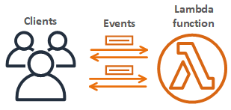
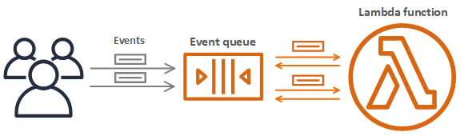
Lambda Service
  Destination
    Asynchronous invocation: Waiting the function finish processing, then return the result
    Synchronous invocation: Lambda will add to the queue to process, then return the result immediately
Asynchronous invocation
Synchronous invocation

Slide 25
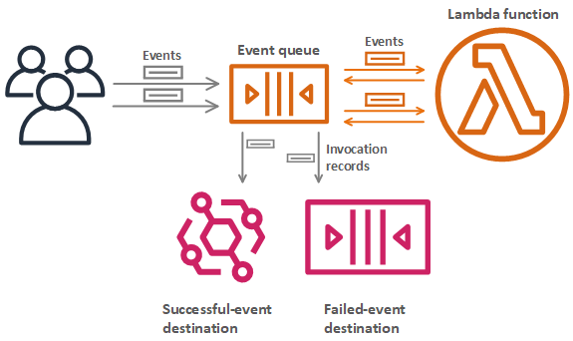
Lambda Service
    When the function finishes processing (success / failure), it will send the record to the destination
    Support SNS, SQS, Lambda Function, Event bus
Asynchronous invocation

Slide 26
Assignment
  Self-practice

Slide 27
Summary
Is a computing service that run code without OS management
Serverless Service, No servers to manage, Just upload code & run on-demand
Integrated with AWS Services (S3, DynamoDB, SQS, SNS, Kinesis, Cognito, ...)
Usecases
  Build data-processing triggers for AWS services (S3, DynamoDB)
  Process streaming data stored in Kinesis
  Using like backend (Auto scaling, HA) for Web/Mobile Application
  CRON Job

Slide 28
Summary
Limit
  RAM: 128 MB 🡪10GB, Disk capacity : 512 MB 🡪 10GB
  Maximum execution time: 15 minutes
  Concurrency executions: 1000
  Deployment size (compressed .zip): 50 MB
Price: Very cheap
Language support: Node.js, Python, Java, C#, Golang, Ruby, ..., Container Image

Slide 29
Summary
Components
  Lambda function: Runtime, Code, Concurrency, Network, Database proxy, File system, Monitoring, ...
  Invoking Function: Test, trigger from AWS Services
  Destination: Asynchronous/Synchronous invocation

Slide 30
Q & A
Copyright © VTI Academy All Rights Reserved

